Slide 1
PVD processes and deposition modelling

Slide 2
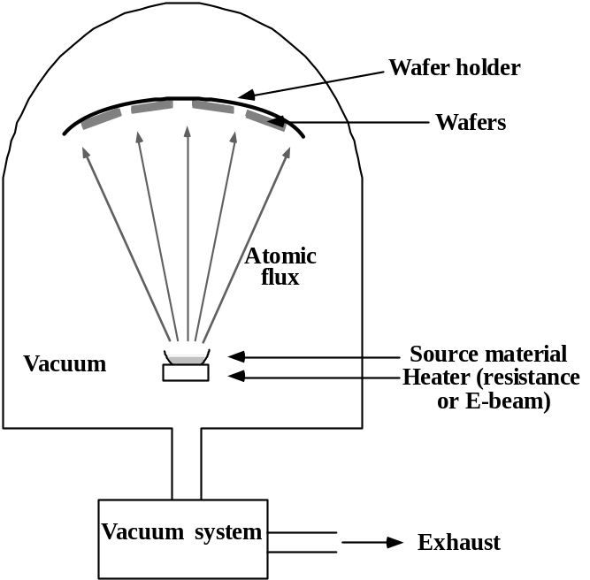
Evaporation
A source material is heated in a vacuum chamber
  E-beam or tungsten filament are used to heat up the crucible containing the material
The source material evaporates or sublimates from the crucible and condensate on wafer surface
No gas phase collision in reactor chamber ( very low pressure)
Line of sight deposition
Dep. Rate is a function of source and reactor geometry
Note:
Evaporation is not commonly used in IC manufacturing today; anyway many concepts will be useful to understand Sputter-PVD

Slide 3
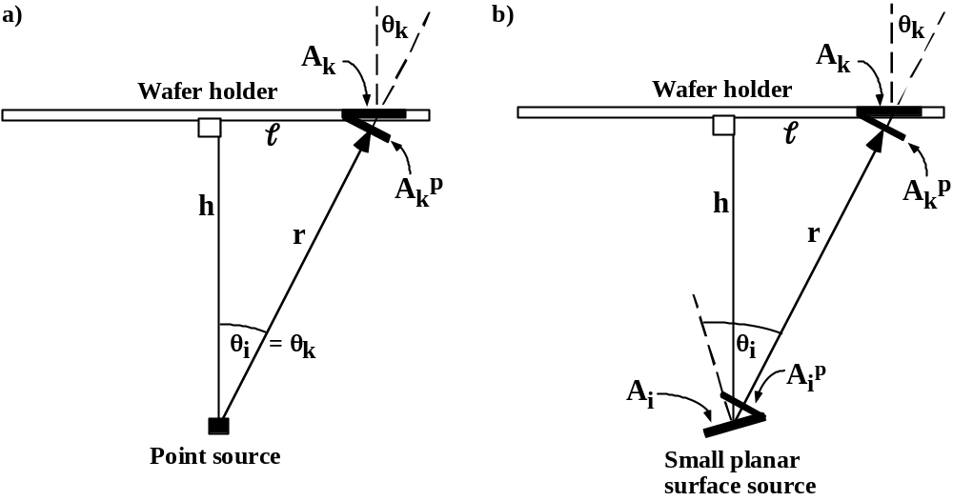
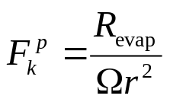
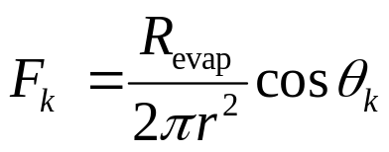
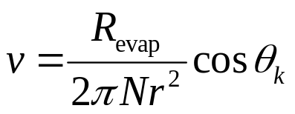
Deposition rate: point source approximation
Uniform emission from a point source → equal evaporation rate in all direction.
Hence, the emitted flux is
Where:
R_{evap} is the evaporation rate
Ω is the solid angle of emission ( 4π in all directions, 2π upward only)
Since the wafer is tilted at a θ_{k} angle with respect to the flow direction, the flow reaching the wafer surface will be
And if N is the material density the deposition rate will be:

Slide 4
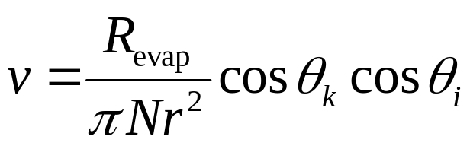
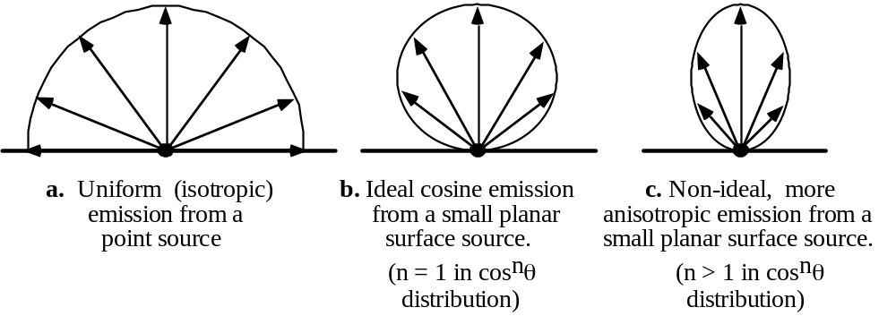
Deposition rate: small surface source
A small planar surface emission can be modelled as a cosine emission or perfectly diffused emission.
Adding a 2cosθ_{i} term to the point does the trick ( 2 allows for normalization of total evaporation rate)
Different, more realistic, angular distributions can be modelled as cos^{n}θ_{i} functions, with n>1.

Slide 5
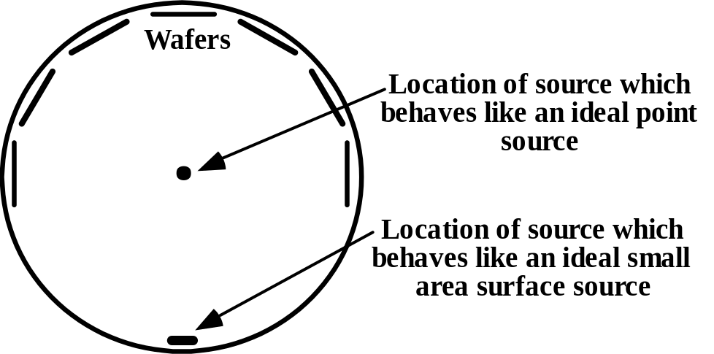
Deposition rate uniformity
No matter if the source can be approximated to a point or surface source → evaporator deposition rate is not uniform on wafer
To maximize deposition uniformity, wafers are put in spherical or hemispherical holders (planetary). Planetary can also rotate

Slide 6
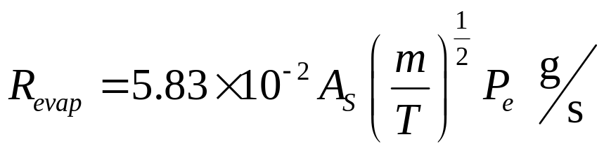
Evaporation rate
Form Langmuir-Knudsen theory
With
A_{s}= area of the source (cm²)
m = gram-molecular mass
T = temperature in K
P_{e}= vapour pressure → a partial pressure of 1-10 mtorr is required to obtain reasonable deposition rates
Note that P_{e} dramatically depends on temperature
‘
10
0
Ag
Ga
Au
Ni
Na
10
-1
Cr
10
-2
Pt
Vapor pressure (torr)
Al
10
-3
In
10
-4
W
10
-5
Ti
Mo
10
-6
0 500 1000 1500 2000 2500 3000
Temperature (ÞC)

Slide 7
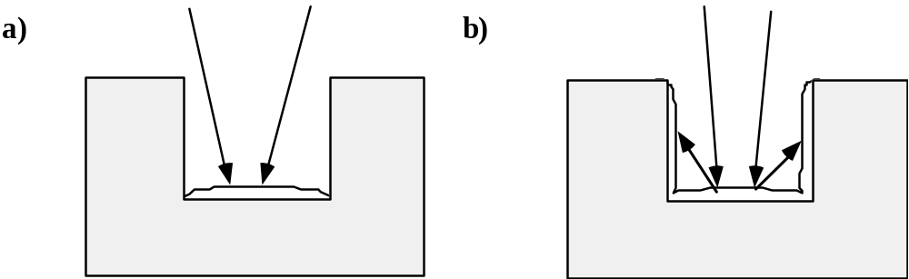
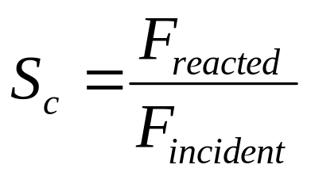
Evaporation: pros and cons
Almost every material can be evaporated
Low wafer contamination and damage
Metals with low P_{e} (e.g. W) are difficult to evaporate
No in-situ pre-cleaning
Alloys deposition is a difficult task ( due to different P_{e} of different materials → multiple crucible and heating system needed → uniformity problems)
Line of sight deposition, no resputtering, sticking coefficient≈1 →poor step coverage
S_{c}=1
S_{c}<1

Slide 8
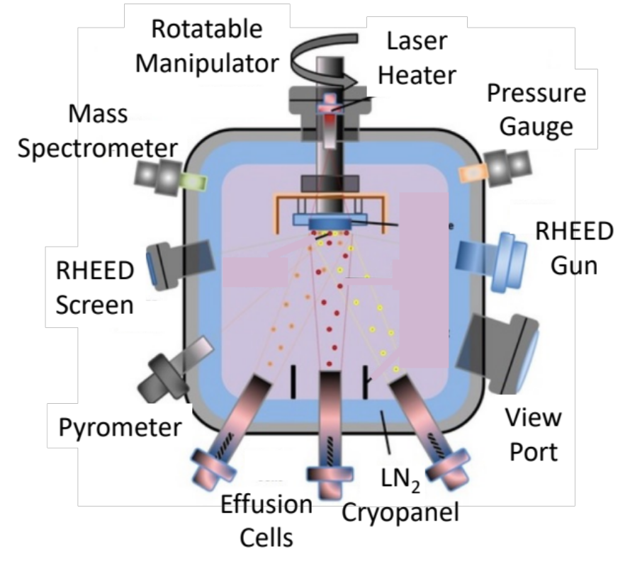
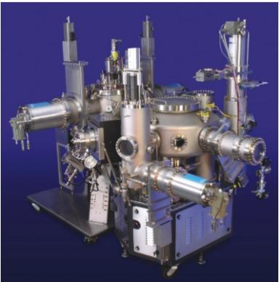
MBE: Molecular Beam Epitaxy
• Operates under high vacuum, line of sight deposition, epitaxial layers can be deposited if substrate is heated to
provide thermal energy.
• Deposition rate usually slow so epitaxial growth can occur (≈ 1 atomic layer/sec).
• “Effusion” sources used to evaporate elements needed for thin films to be deposited. T of effusion cells
controls relative evaporation rates.
• Widely used in university and industry research, generally too slow for manufacturing.

Slide 9
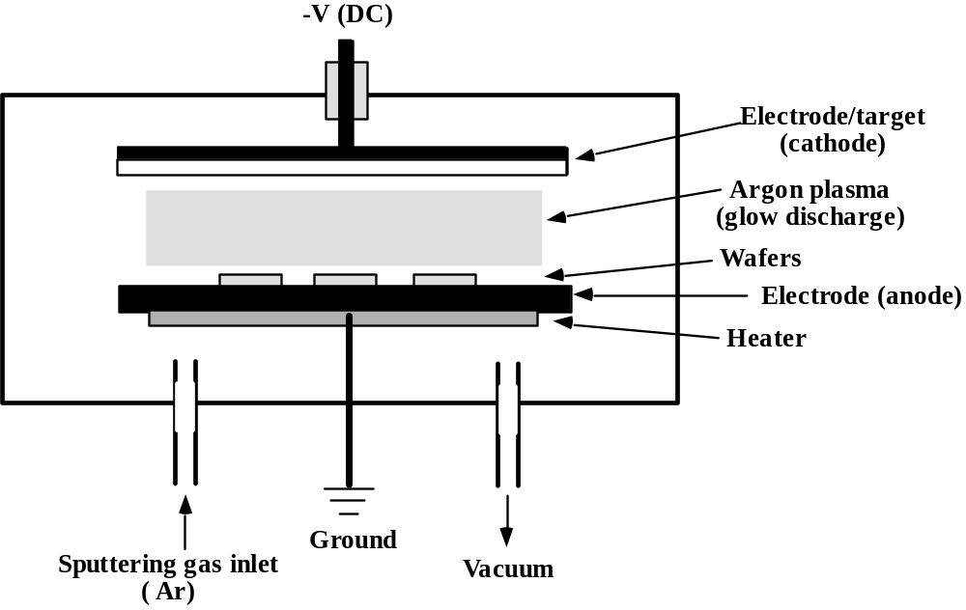
Sputter deposition
In sputter deposition a plasma (usually Ar) is used to dislodge atoms form a source “target” → the atoms the are deposited on the wafer
Higher pressures compared to evaporation (1-100 mTorr)
Alloys can easily be deposited

Slide 10
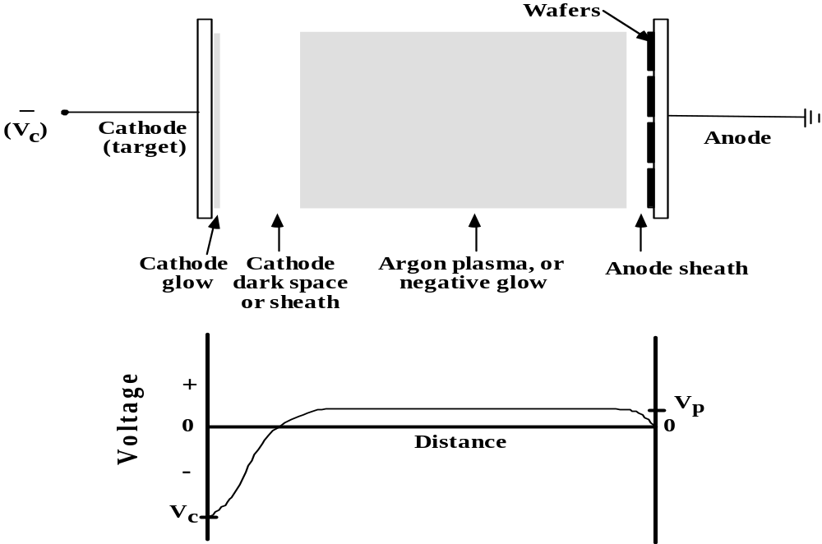
DC sputter deposition
A net DC current flows in the circuit
In the cathode region the current is carried by ion flux ( which also sputters atoms from the target)
In the anode region the current is mainly due to electrons. Due to the maxwellian distribution of electrons a small drop in the plasma potential is enough to sustain the anode current.

Slide 11
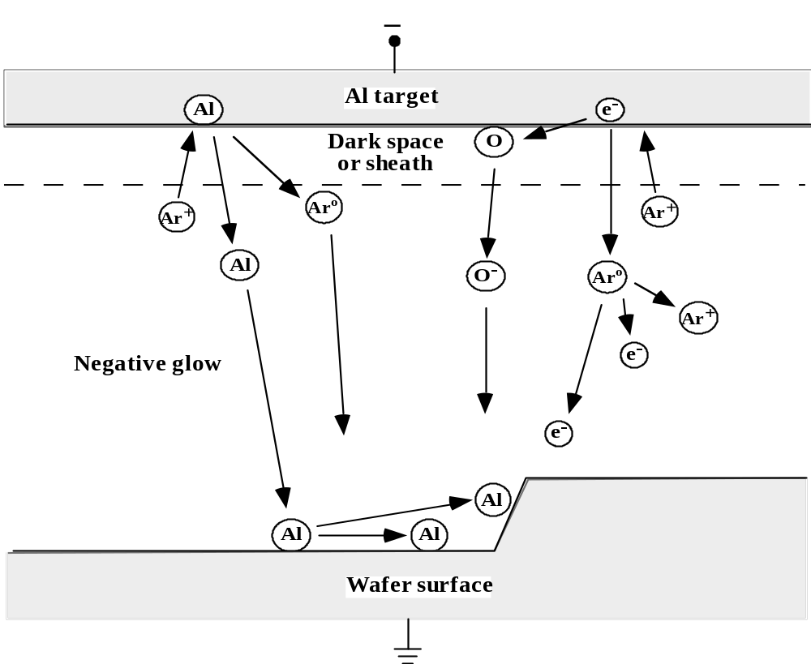
DC sputter deposition
Ar ion accelerated in the sheath sputters a target atom ( e.g. Al)
The Al the migrates to the wafer surface where it can:
Stay absorbed
Migrate to another surface site
Be re-emitted
The Ar ion can be neutralized during sputtering and incorporated in the growing film
Secondary electrons can be emitted by the target during sputter; they can:
Ionize impurity that travel to the wafer surface
Ionize Ar and sustain plasma

Slide 12
Sputtering yield
Deposition rate depends on sputtering yield Y and arrival angle distribution.
Y = n. of sputtered atoms/n. incident ions ranges between 0.1 and 3 for different materials. Depends on:
  Material being sputtered
  Ion energy
  Ion arrival angle
Alloy are easily deposited even if the source materials have very different Ys. Sputter happens mostly at the target surface:
  At the very beginning: higher Y material is sputtered
  More low Y material atoms are available at the surface after some time
  At steady state the elements leave the surface at the same ratio as bulk material composition→ different Y are compensated by different surface concentrations

Slide 13
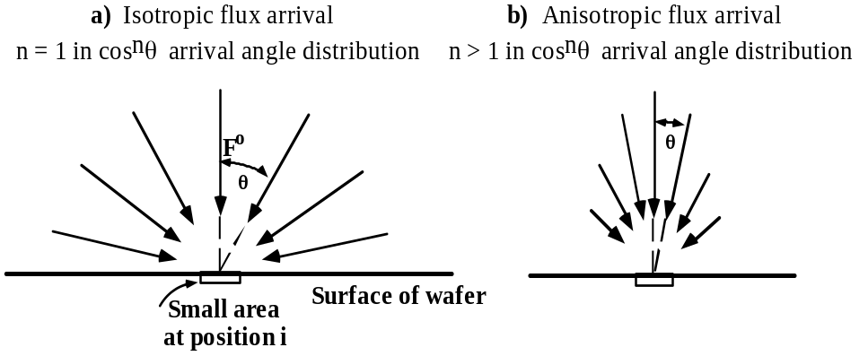
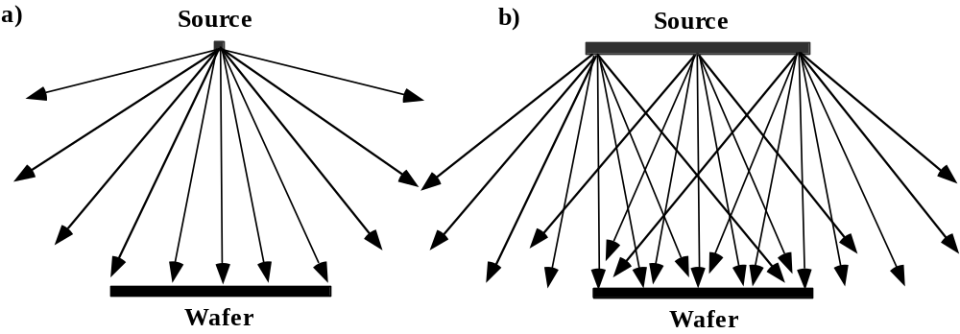
Arrival angle distribution
Arrival angle distribution generally described by cos^{n}θ distribution (the normal component of flux striking the surface detrmines the deposition or growth rate).
Size and type of source, system geometry and collisions in gas phase important in arrival angle distribution.
Sputtering targets are generally large and provide a wide range of arrival angles in contrast to a point source.

Slide 14
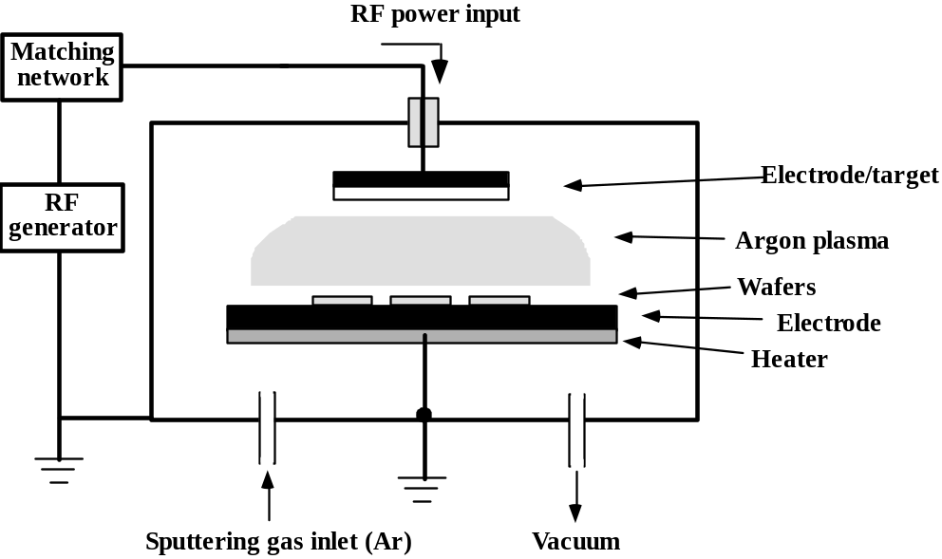
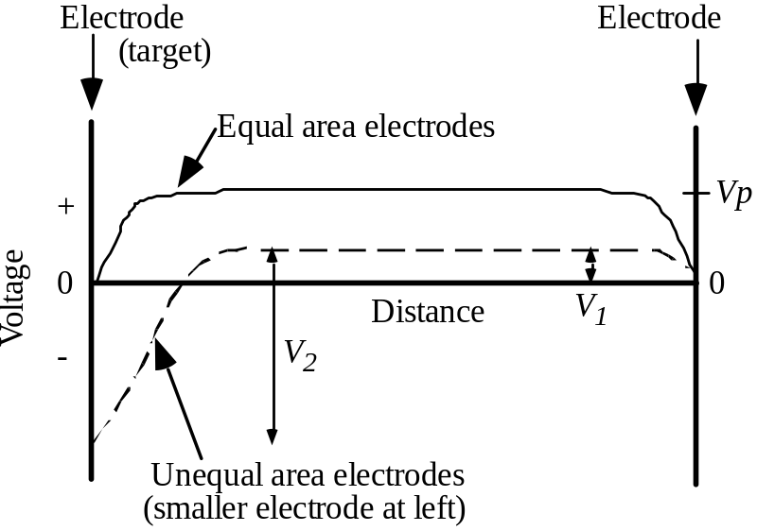
RF Sputter deposition
In DC sputter target must be conductive → RF sputter is used for dielectric deposition
Sheath and plasma potential formation are similar to the DC case →
  in the first RF cycles electrons (more mobile than ion s) are collected at electrodes and a negative charge builds up
  Sheaths are formed and guarantee a self-biasing steady state at electrodes →continuous sputtering
  Plasma potential builds up to ensure that net DC current is 0

Slide 15
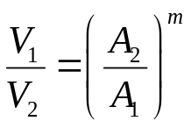
RF Sputter deposition
If electrodes area are the same, sheaths and potential drops are symmetrical. The wafer is puttered too !
It can be shown that if the electrodes areas are different, the voltage drop ratio is:
With m=4 from theory, 1-2 experimentally.
Sputter at wafer side can be significantly reduced ( the wafer holder is often connected to the chamber wall to increase the electrode area)

Slide 16
Other sputtering processes
Reactive sputter deposition
  A reactive gas is added in the plasma, and it concurs to the layer deposition. Es. TiN is deposited using a Ti target and an Ar/N₂ plasma.
Bias sputtering
  The wafer side can be opportunely biased in order to perform some sputter etch for surface cleaning, or deposition and sputtering at the same time.
Magnetron sputtering
  Magnets are added on the chamber side, to improve ionization in the plasma ( electrons collide with Ar ions with a spiral motion)
Collimated sputtering
  Increases gap filling performances, by allowing narrow arrival angle distribution. Usually, plates with circular or hexagonal holes are placed between the wafer and the target

Slide 17
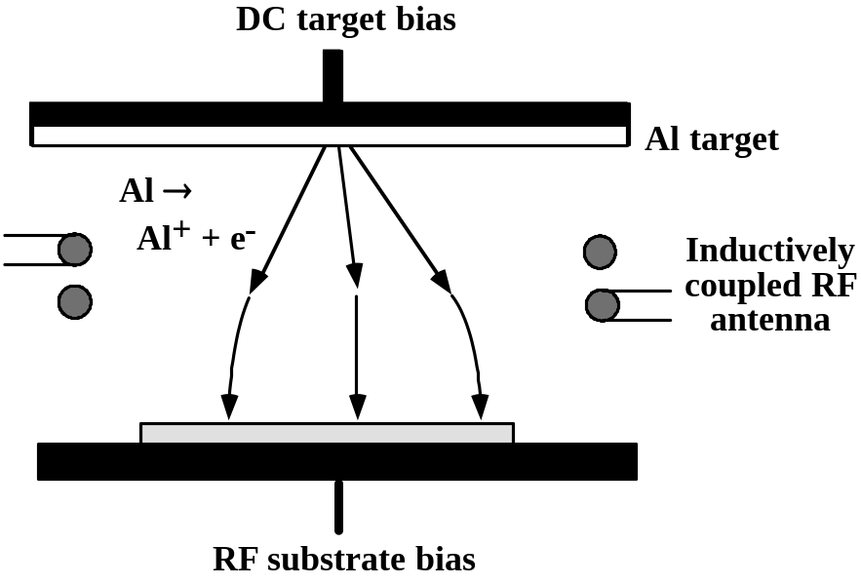
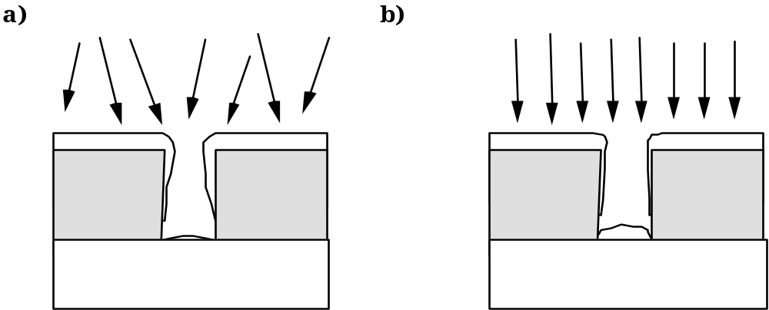
Ionized sputtering
In some systems the depositing atoms themselves are ionized.
An RF coil around the plasma induces collisions in the plasma creating the ions.
This provides a narrow distribution of arrival angles which may be useful when filling or coating the bottom of deep contact hole.

Slide 18
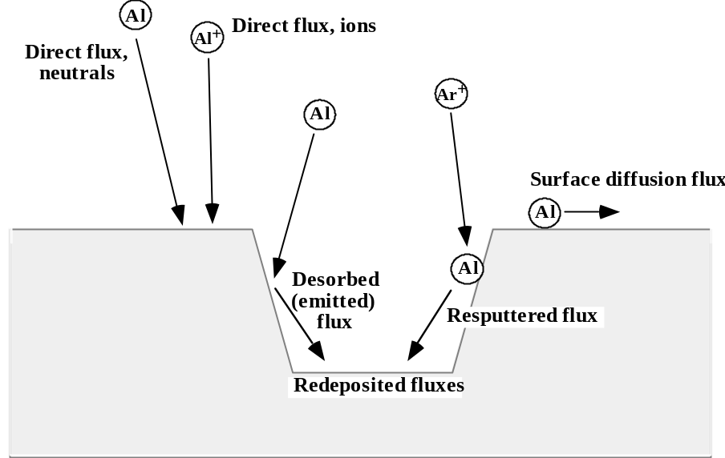
Modelling CVD and PVD deposition
To simulate the deposition in a computer program:
Calculate reactants flow at each point on wafer
Describe mathematically every process

Slide 19
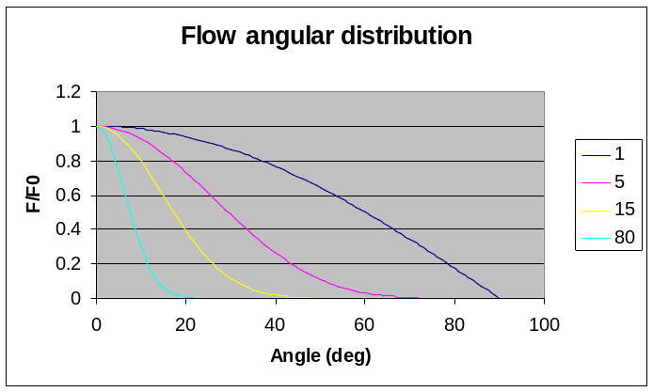
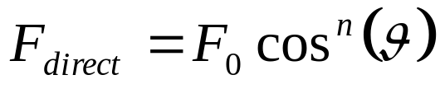
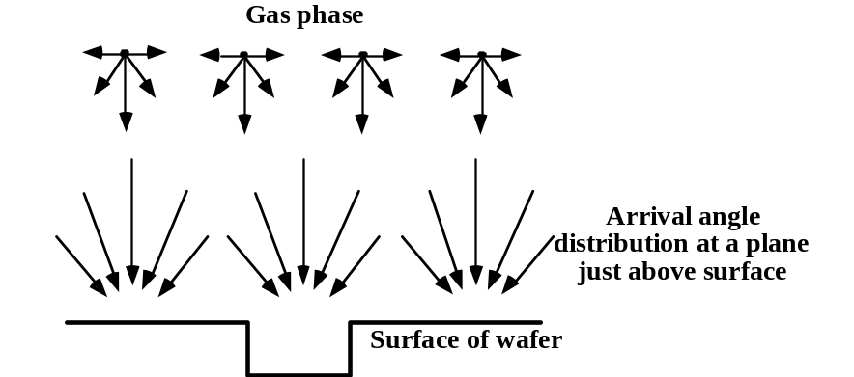
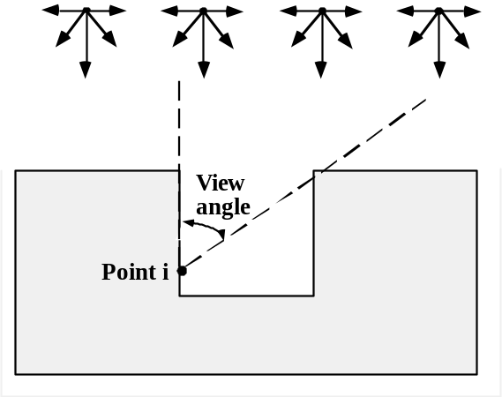
Modelling CVD and PVD deposition
Instead of calculating the trajectory of the species form the source through the reactor, we can simply take into account an angular distribution of the flux at wafer surface (we are interested in the component of the flux normal to the surface) :
n

Slide 20
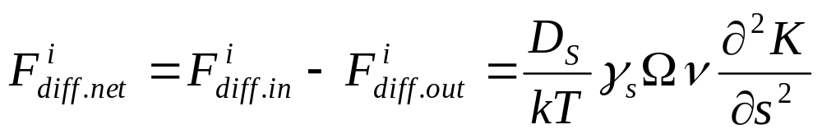
Modelling CVD and PVD deposition
Where:
D_{S} : surface diffusivity
γ_{s}: per area surface energy
Ω: atomic or molecular volume
ν: number of atoms/molecules per unit area
K: curvature
S: unit length across surface

Slide 21
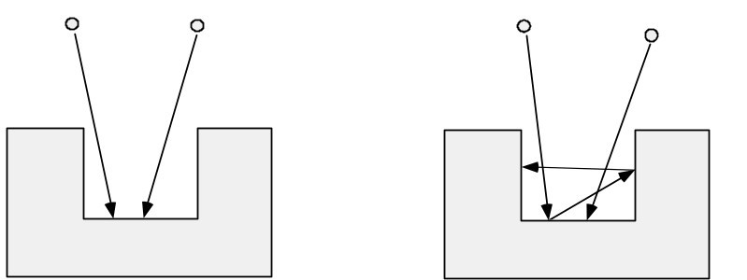
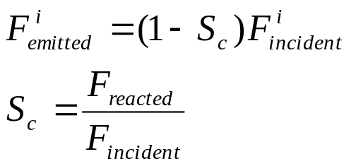
Modelling CVD and PVD deposition
High (S_{c} = 1) Low (S_{c} < 1)
Emission flux is usually considered isotropic (cosine distribution)
The redeposition flow at a point i is calculated taking into account the emission flow form all the points k and the geometrical factor g^{ik} that accounts for distance and orientation between points.

Slide 22
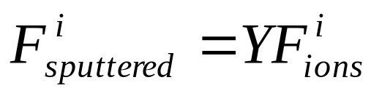
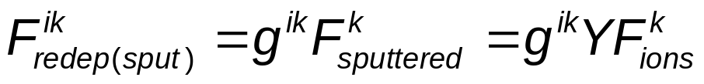
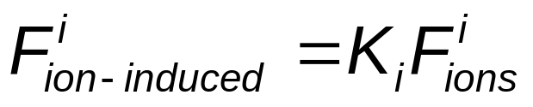
Modelling CVD and PVD deposition
Note that the sputtering yield Y has an angular dependence.
Emission of sputtered ions is usually modelled as cos^{n}(θ), with n<1 for energetic ions and n>1 for low energy sputtering
þ
Sputtered atoms can be redeposited:
3
3
Impinging ions can enhance deposition rate instead of sputtering:
2
2
Normalized Sputtering yield, Y
Normalized sputter etch rate
1
1
0
0
1
0
2
0
3
0
4
0
5
0
6
0
7
0
8
0
9
0
0
Incident angle

Slide 23
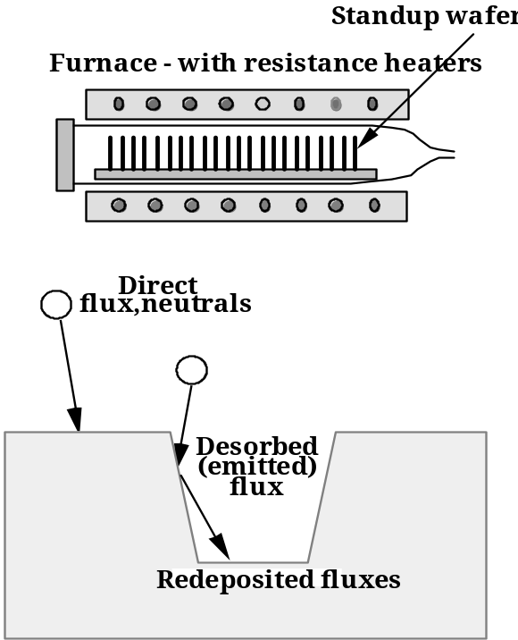
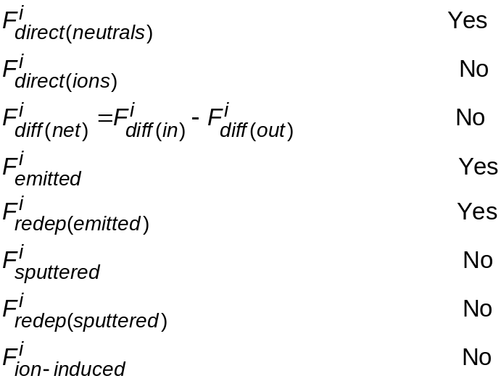
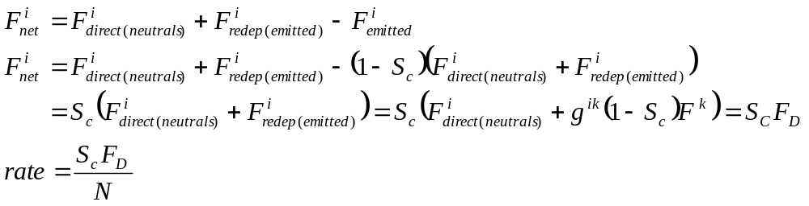
LPCVD modelling

Slide 24
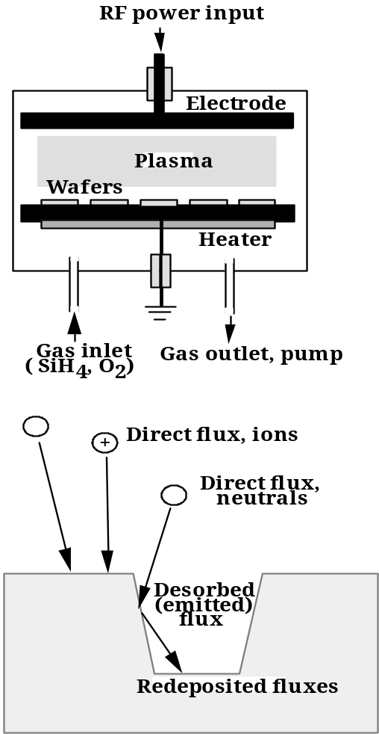
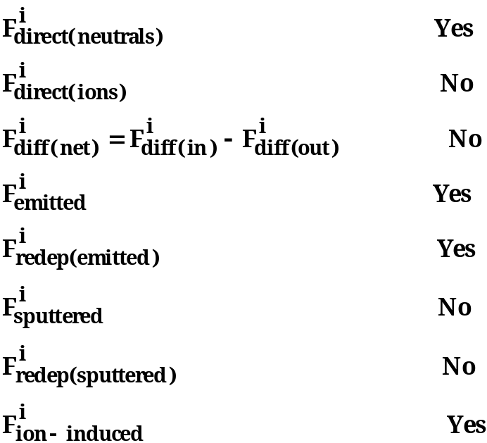
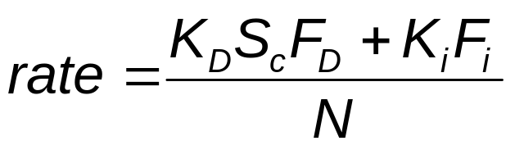
PECVD modelling
Where K_{D} is a specific rate constant for non-ion-enhanced deposition component

Slide 25
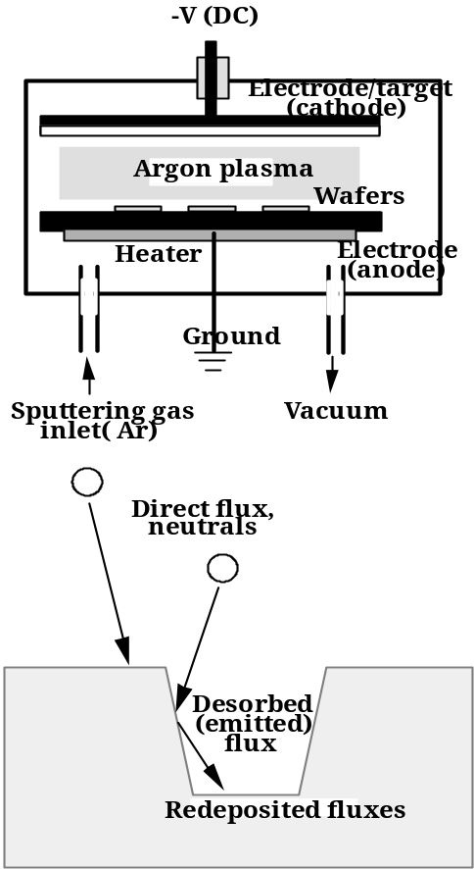
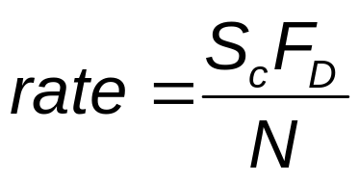
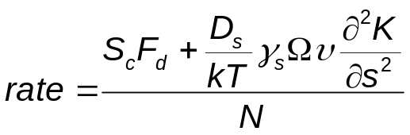
PVD modelling
Ions don’t play a significant role, so modelling is the same as in LPCVD systems (with different flux distribution and S_{C)}
If high T are used, surface diffusion must be taken into account

Slide 26
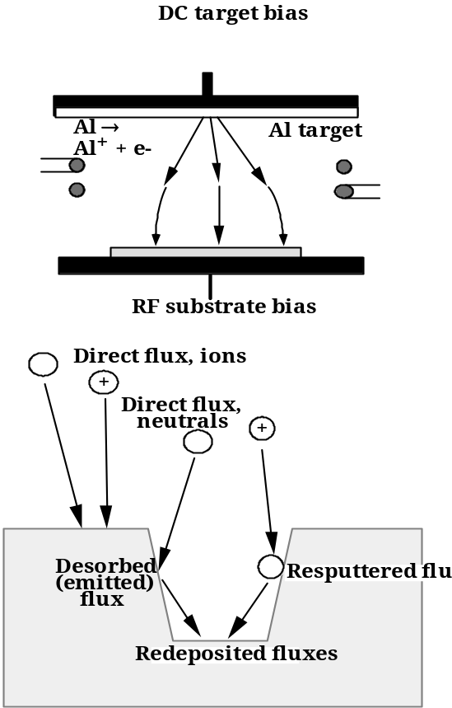
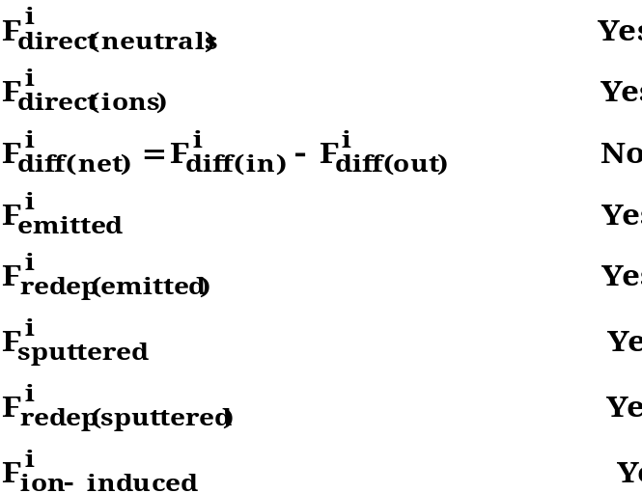
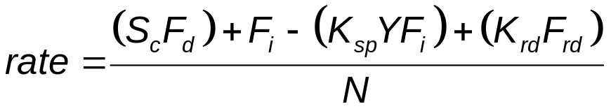
Ionized-PVD modelling

Slide 27
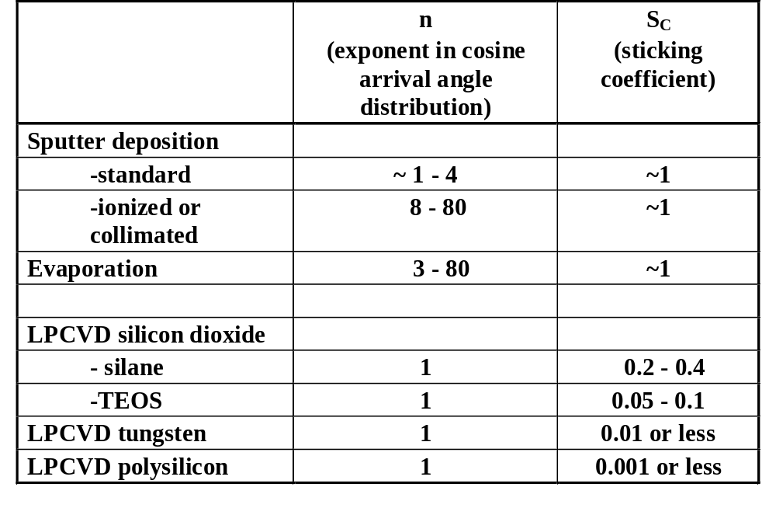
Thin film deposition: deposited materials and methods

Slide 28
Bibliography for this lesson
J.D. Plummer, “Silicon VLSI technology. Fundamentals, practice and modeling” , Prentice Hall 2000
S.A. Campbell, “The science and engineering of microelectronic fabrication”, Oxford University Press 2001
M. Alonso, E.J. Finn, “Elementi di Fisica per l’Universitá”, Masson/Addison Wesley 1993
M.A. Lieberman, A.J. Lichtenberg, “Principles of plasma discharges and materials processing”, Wiley-Interscience 2005

